Slide 1
Networking with Wireshark
Unit 5.2
Cybersecurity Boot Camp |

Slide 2
Activity: Leaky HTTP Traffic (10 min)
In this partner activity, you’ll use Wireshark to retrieve a user’s username and password being communicated through an insecure website
Instructions:
Initiate a Wireshark capture.
Open a Chrome window using incognito mode (`Ctrl+Shift+N` or `Cmd+Shift+N`).
Navigate to the webpage www.aavtrain.com. Attempt to login using a dummy username and password.
Return to your Wireshark window and stop the capture.
See if you can identify the packet relevant to your form submission. (Hint: Google GET and POST request..)
Once you identify the relevant row, see if you can extract from the packet data the username and password you entered.
Turn to the internet to find out how this plaintext password communication can be avoided (hint: HTTPs)

Slide 3
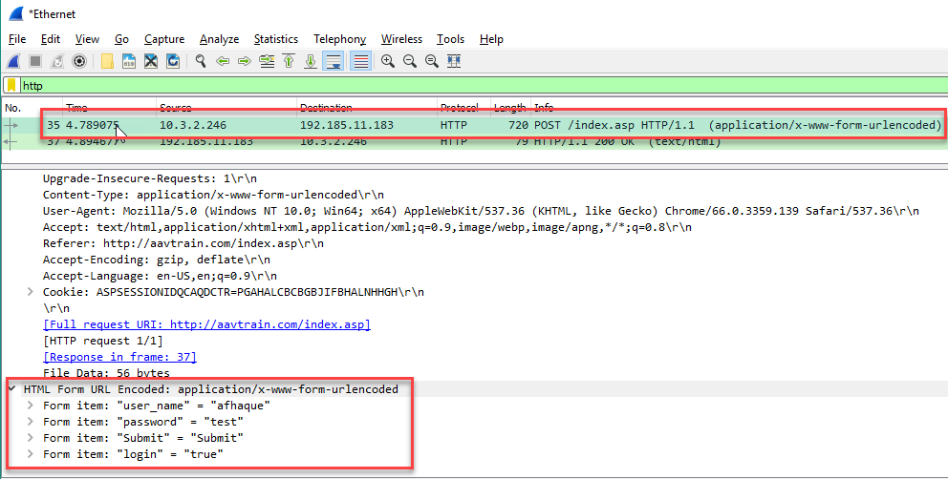
Review Leaky HTTP Traffic

Slide 4
Today’s Goals
By the end of class, you will be able to:
Describe the flow of typical HTTP conversations at the application layer
Describe the flow of DNS conversations at the application layer
Describe the flow of typical TCP conversations

Slide 5
HTTP

Slide 6
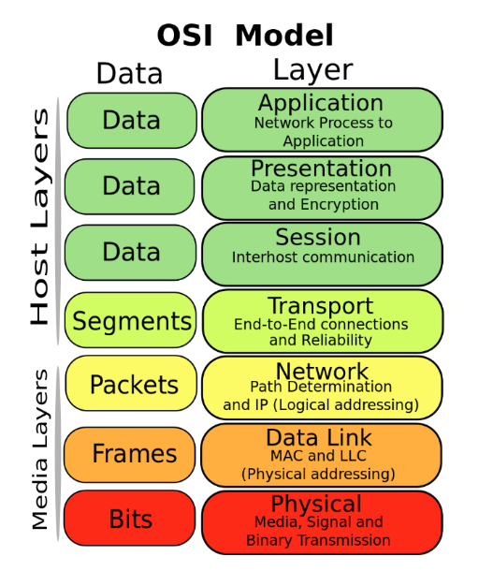
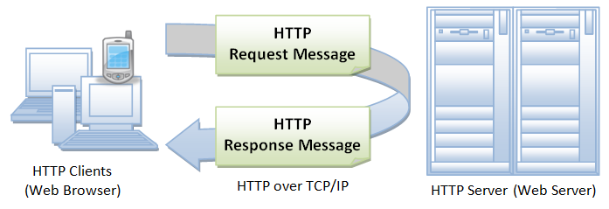
HTTP- Hypertext Transfer Protocol
Typically uses client/server architecture.

Slide 7
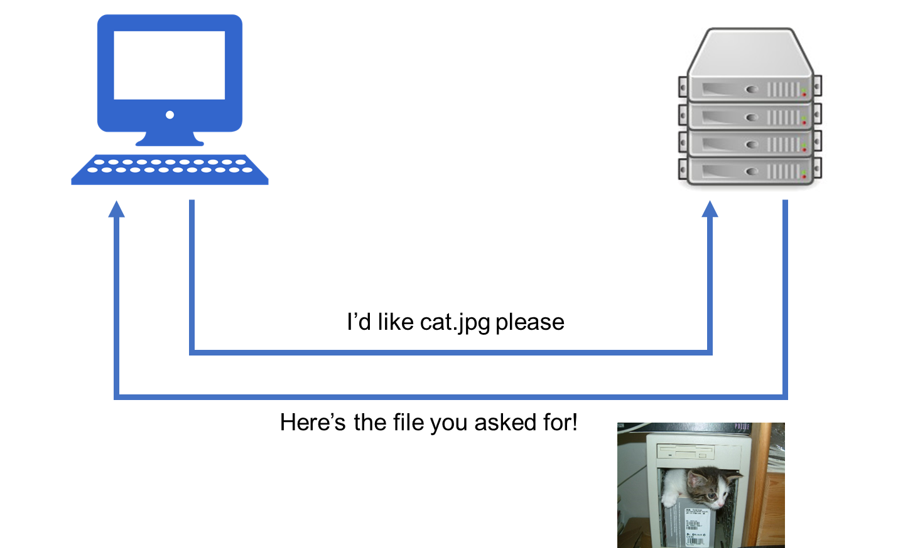
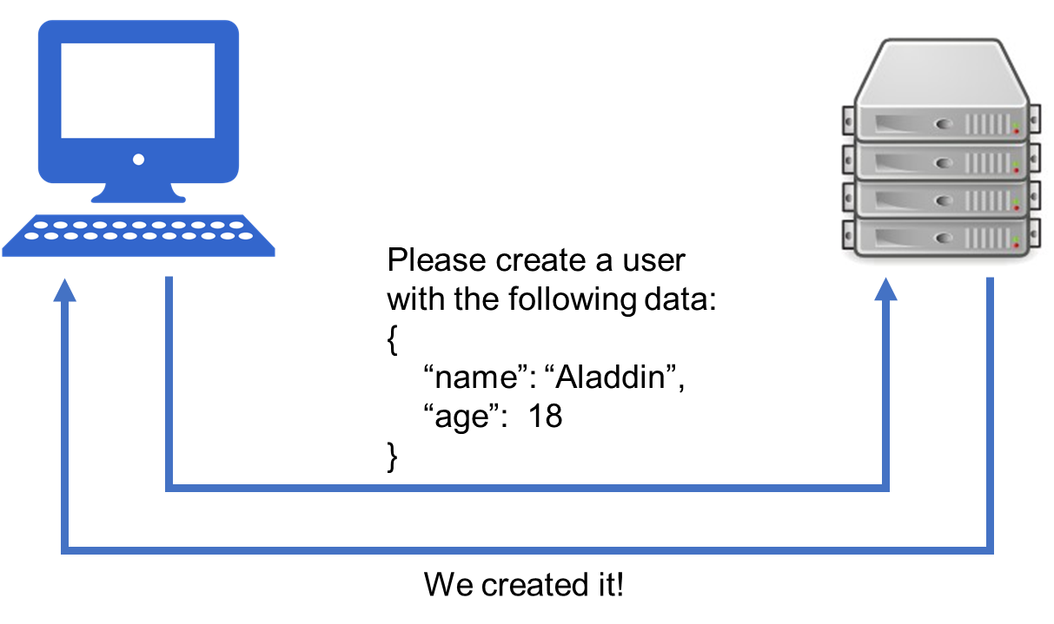
HTTP Request Methods
GET /cat.jpg HTTP/1.1
POST /users HTTP/1.1 … { “name”: “Aladdin”, “age”: 18 }

Slide 8
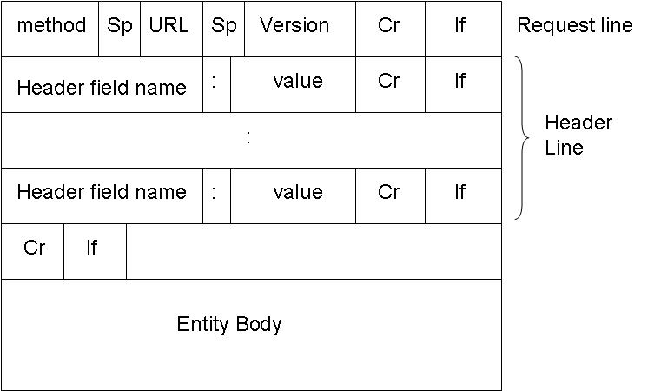
HTTP Request
Example HTTP Request:
GET /hello.txt HTTP/1.1
User-Agent: curl/7.16.3 libcurl/7.16.3 OpenSSL/0.9.7l zlib/1.2.3
Host: www.example.com
Accept-Language: en, mi

Slide 9
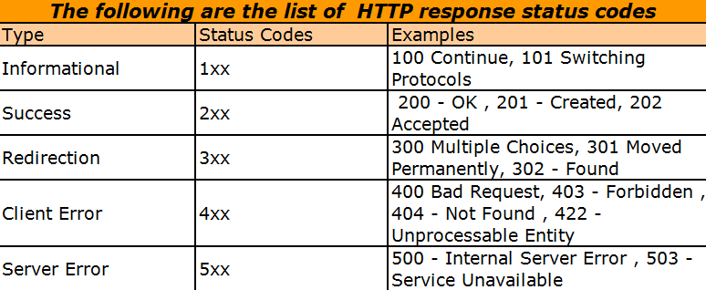
HTTP Status Codes
Source
Notes:
Status codes are numbers which indicate how the server dealt with the response, and/or other problems that may have been encountered.

Slide 10

HTTP vs HTTPs
HTTPs (HTTP Secure) uses an SSL certificate (TLS) to encrypt data before sending, and decrypt upon arrival

Slide 11
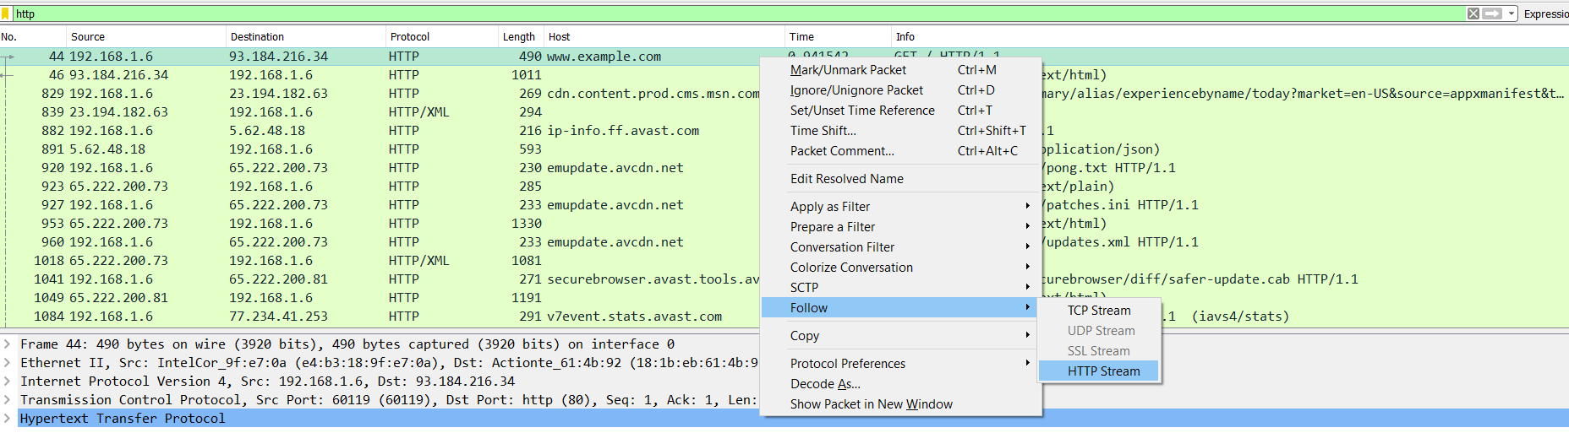
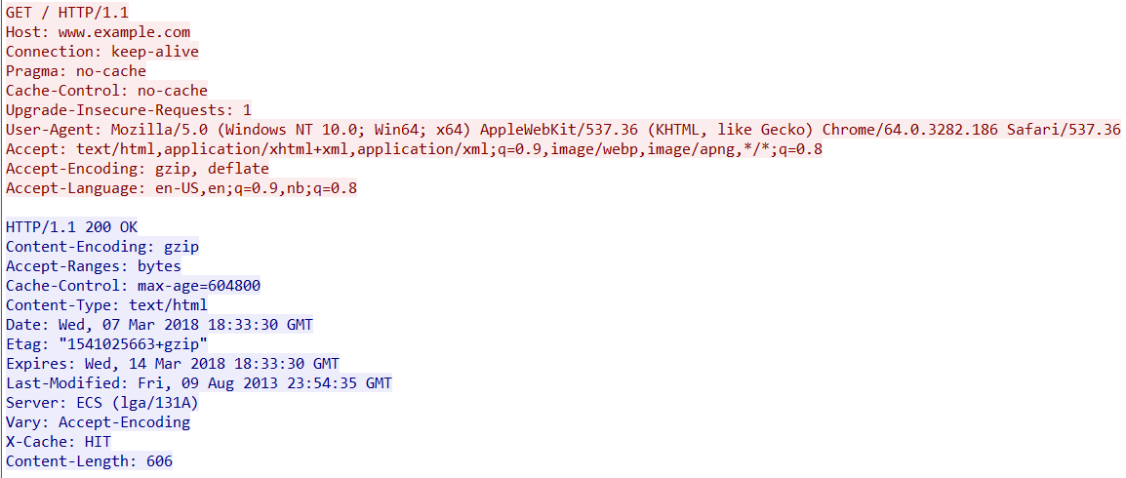
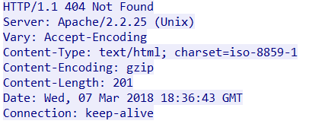
Wireshark HTTP Demo
Instructor Demo

Slide 12
Activity: Analyzing HTTP (20 min)
In this activity, you will look at look at HTTP conversations to reverse-engineer the HTTP protocol.
Instructions:
Open up the provided file with Wireshark and complete the activity using the instructions sent to you.

Slide 13
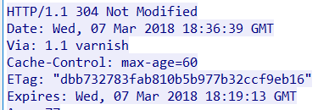
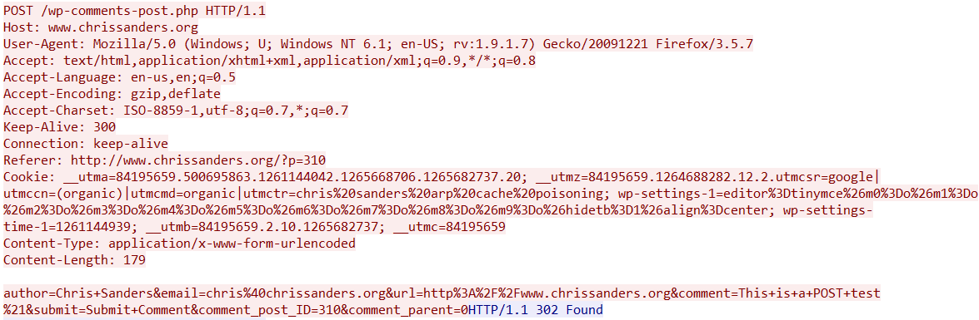
Review: Wireshark HTTP Analysis
Instructor Review

Slide 14
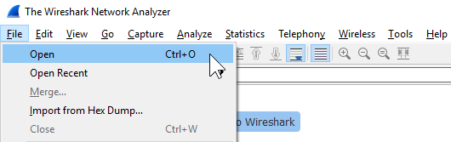
Activity: The Search for Something Cool (15 min)
In this activity, you’ll import a pcap file and try to retrace a user’s browsing history.
Instructions:
Open up the provided file with Wireshark and complete the instructions sent to you.

Slide 15
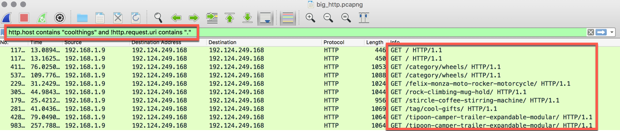
Review The Search for Something Cool

Slide 16
Today’s Goals
By the end of class, you will be able to:
Describe the flow of typical HTTP conversations at the application layer
Describe the flow of DNS conversations at the application layer
Describe the flow of typical TCP conversations
Notes:
But today, we’re going to… Review goals, address questions.

Slide 17
Break (15 min)

Slide 18
DNS

Slide 19

DNS
Hi, can you please send me Google’s webpage?
I don’t know what that is. Do you have an IP address?
...

Slide 20
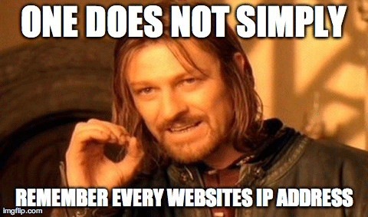
DNS

Slide 21
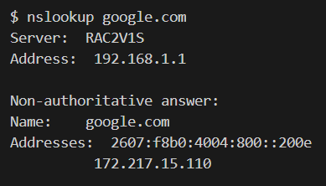
Domain Names

Slide 22
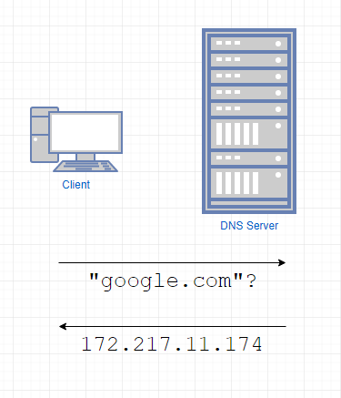
DNS

Slide 23
Subdomains
iAmTheBest.com also includes:
mail.iAmTheBest.com
blog.iAmTheBest.com
music.iAmTheBest.com
Notes:
Resolving the domain name

Slide 24
DNS Record Types
DNS allows you to query for more than just domain -> IP address. These other features are called record types:
A record - IPv4 address from a hostname query
AAAA record - IPv6 address from a hostname query
MX record - mail server for the domain
CNAME - alias to the domain name
NS record - nameserver of the domain
PTR record - hostname from an IP address
…plus many more.

Slide 25
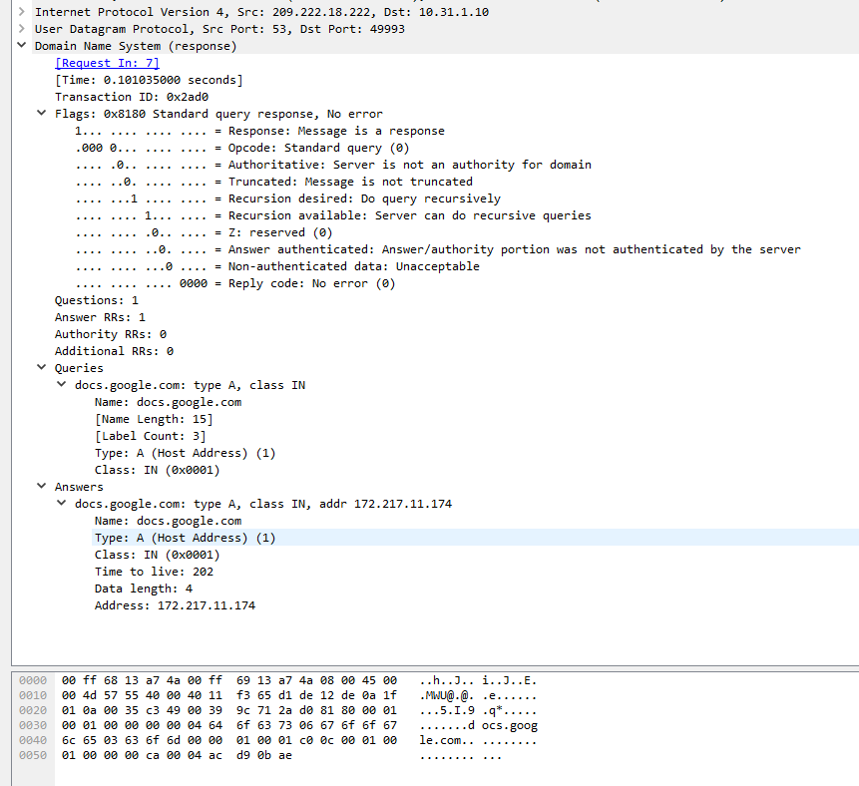
Demo: DNS in Wireshark
flags
original query and answer

Slide 26
Activity: Wireshark DNS Analysis (10 min)
Instructions:
Part 1:
Open the `dns-1.pcap` file.
This file only contains DNS replies. How many DNS requests were there?
When the user asked for `assets.espn.go.com`, what happened?
What is/are the IP address(es) for `a1.espncdn.com`?
Part 2:
Open the `dns-2.pcap` file.
This capture contains an attempted query, but something went wrong.
What happened?
Which flag in the packet reveals what went wrong?
The request went to 8.8.8.8. Did the response come directly from 8.8.8.8?

Slide 27
Review Wireshark DNS Analysis
Instructor Review

Slide 28
Today’s Goals
By the end of class, you will be able to:
Describe the flow of typical HTTP conversations at the application layer
Describe the flow of DNS conversations at the application layer
Describe the flow of typical TCP conversations
Notes:
But today, we’re going to… Review goals, address questions.

Slide 29
Transport Layer Protocols

Slide 30
Transport Layer Protocols

Slide 31
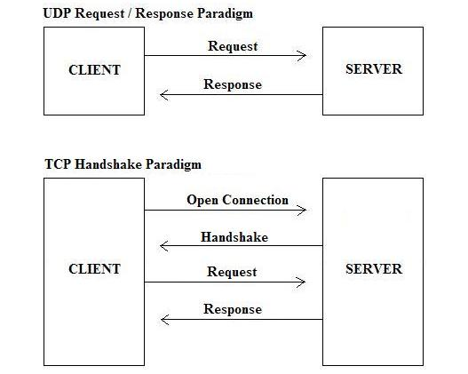
Transport Layer Protocols
Two most common protocols: UDP and TCP

Slide 32
UDP

Slide 33
TCP

Slide 34
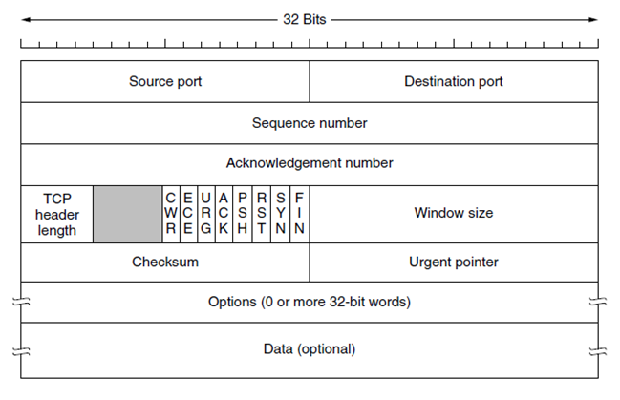
TCP – Headers and Flags

Slide 35
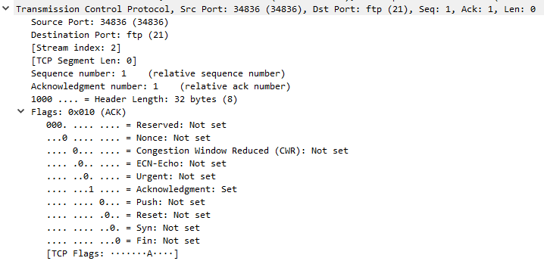
TCP – Headers and Flags
Flags in TCP Header

Slide 36
TCP – Headers and Flags
SYN – Synchronization – first step in establishing handshake between hosts
ACK – Acknowledgement – used to acknowledge successful receipt of a packet
PSH – Push – tell recipient to process this packet as it is received, don’t buffer it
RST – Reset – sent when a packet was sent that was unexpected
FIN – Synchronization – first step in establishing handshake between hosts

Slide 37
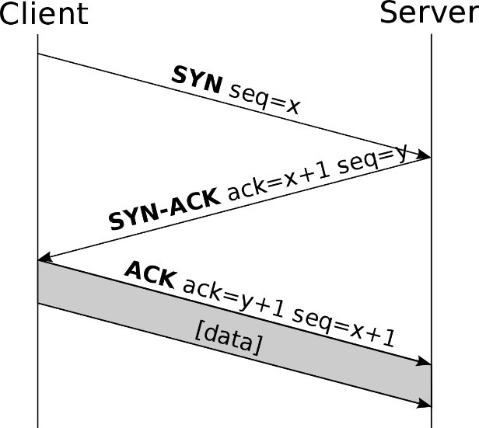
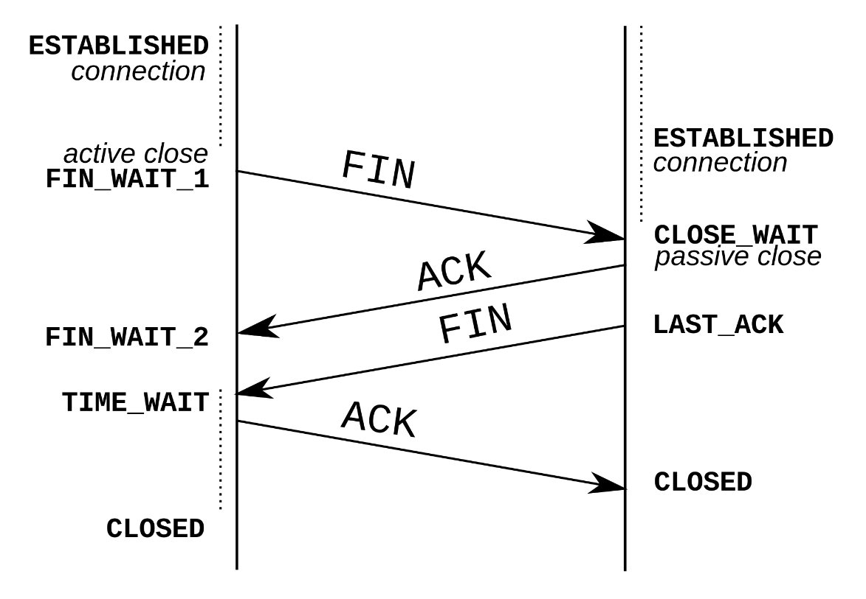
TCP
TCP Handshake
Connection-Oriented
3-way handshake, 4-way close
Setup: SYN, SYN-ACK, ACK
Teardown: FIN, ACK, FIN, ACK

Slide 38
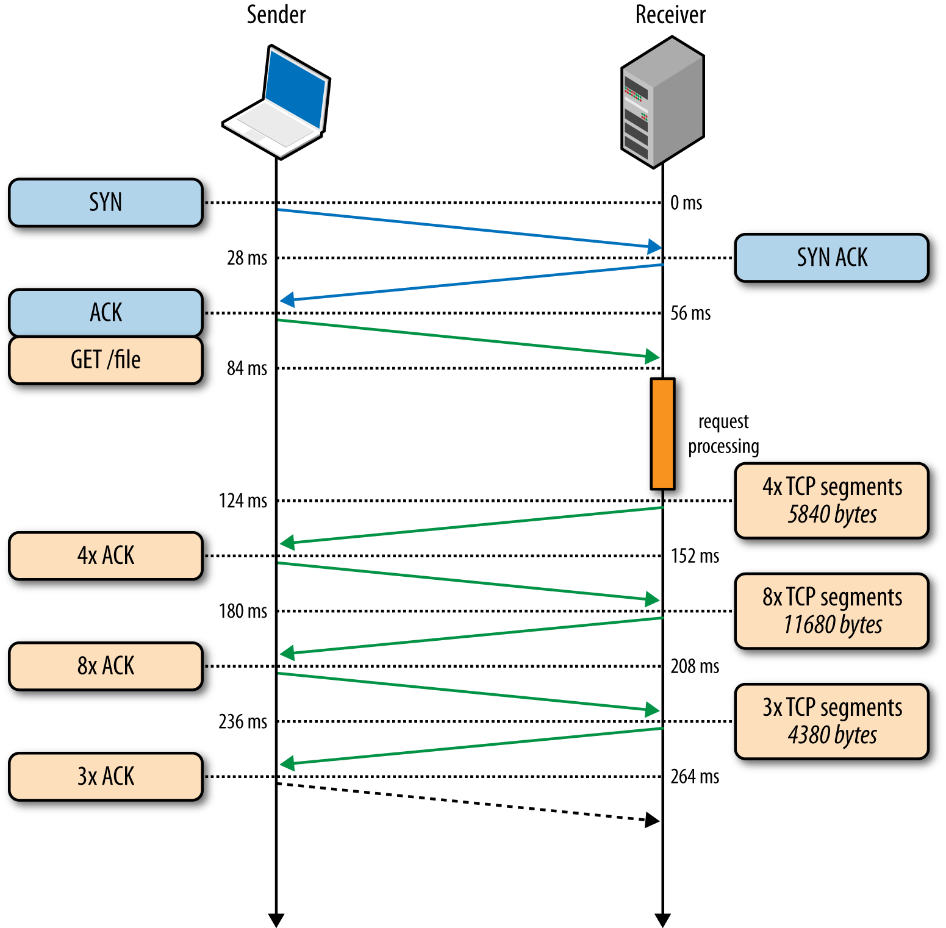
TCP with Request/Response

Slide 39

TCP vs UDP
You want your friend’s toy.
TCP
You call his phone number.
He picks up and says “Howdy, Buzz”
You say “Hey, Woody”
You ask for the toy.
He sends you the toy.
UDP
1. You call and leave a voicemail that you want his toy.
2. Your toy might come in the mail.
3-way handshake
Notes:
In the analogy, the phone number is the IP + Port
He knows it’s you when he picks up because of “caller id” – information about who you are was sent with your call. (SYN)

Slide 40
TCP vs. UDP - Jokes
In high society, TCP is more welcome than UDP. At least it knows a proper handshake.
I’d tell you a UDP joke but you might not get it.

Slide 41
Activity: Explain/Draw the Process (10 min)
You now know all of the basics of what happens in layers 4-7 of the OSI Model. Let’s practice explaining it!
Instructions:
Draw the process of request/response for an HTTP page through the network in the context of the OSI model, labelling:
The protocol(s) used at each layer
How the protocol works at that stage of the process
The format of the data at that point in the layer
When confident in your drawing, compare with your partner’s drawing. Try to explain your diagram, and note any differences between the two.
Act out the TCP communication and handshake process with your partner.
Bonus: Do the same for DNS

Slide 42
Review Explain/Draw the Process
Instructor Review

Slide 43
Activity: Digging into TCP Communications (15 min)
Let’s investigate TCP in action!
Instructions:
Open the `tcp.pcapng` file with Wireshark
Filter for TCP packets only.
Find all TCP SYN packets.
Find all TCP FIN packets.
Filter for a single TCP stream using the "FTP" protocol.
Find the 3-way handshake sequence.
Find the TCP teardown sequence.
What are the source/destination IP addresses and ports?

Slide 44
Review Digging Into TCP Communications
Instructor Review

Slide 45
Today’s Goals
By the end of class, you will be able to:
Describe the flow of typical HTTP conversations at the application layer
Describe the flow of DNS conversations at the application layer
Describe the flow of typical TCP conversations

